Slide 1
Customer Discovery Startup Toolkit
Version 1.0

Slide 2
What is customer discovery?
Is the process of developing assumptions related to the questions:
- Who are your customers? - What problem(s) do your customers have that you will solve? - How will you solve their problem(s)? -How will your customers adopt your solution?

Slide 3
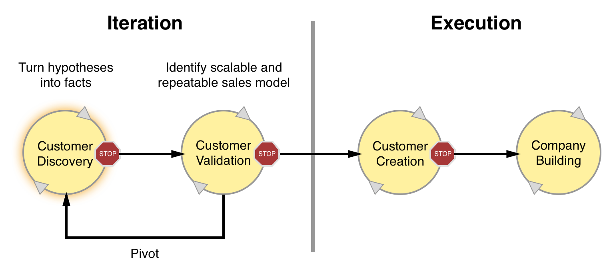
The customer analysis journey

Slide 4
Discovery and development...
Customer Discovery is the first step of a 4-stage journey, that begins with the understanding of the customer (Discovery) and the validation of a sales model (Validation)…

Slide 5
...creation and building
…and ends with the growth of the customer base (Creation) and the transition from a startup to a fully-fledged business (Building).

Slide 6
Why doing it?
- Investors look for it
- The competition is doing it
- Initial market assumptions are likely incorrect

Slide 7
Customer Discovery goals
Checking if a problem exists for a given target
Learning how the customer thinks
Getting feedbacks on product/service

Slide 8
Customer Discovery Steps
Before going out of the building
Going out of the building
Back to the building

Slide 9
Before going out of the building
Perform dry runs interviews between founders and colleagues to see if the planned interview works well and for practicing in general

Slide 10
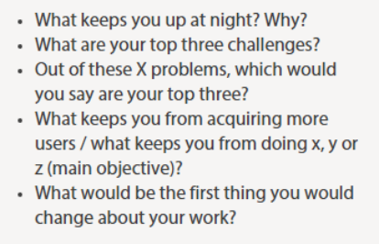
Relevant questions
Prepare relevant questions that go deep into the problem, without talking about solutions

Slide 11
Out of the building
Allow casual, non structured conversation
Don’t interrupt the customer flowing story
Ask for referrals
Search for patterns and insights
Never talk about the solution!

Slide 12
The first rule of the Discovery Club
NEVER talk about your idea.

Slide 13
Henry Ford tells us why

Slide 14
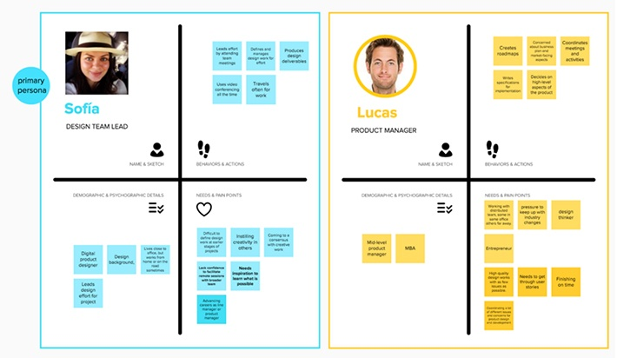
Back to the building: Proto Personas
Proto-Personas are user archetypes
3-5 for each project
Characterized by needs, behaviours, habits, demographics
Assemble what you learnt in the interviews in proto personas

Slide 15
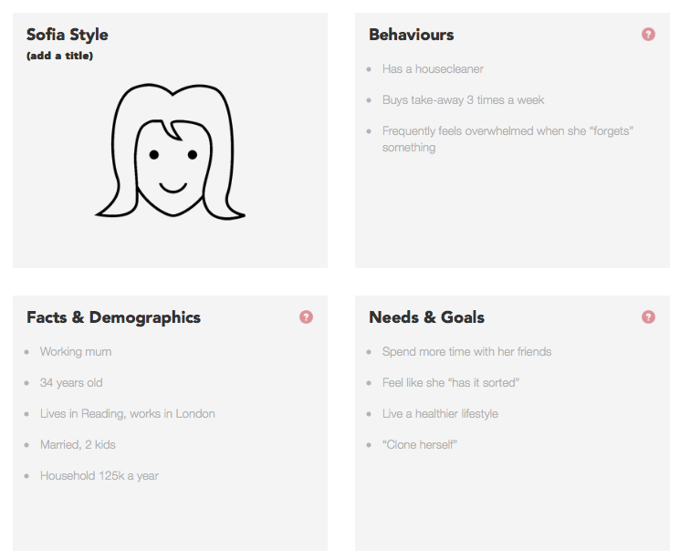
Understanding Proto-Personas
Understanding personas allows us to understand how, when and what we can ask the customers
Use the proto personas canvas to define your personas

Slide 16
Tips & Tricks
Write down the most significant insights just after the interview
Put your leads at ease
Talk only to people in your target
Do 15-20 interviews

Slide 17
Thank you

