Slide 1
Growth Hacking Enel Toolkit
Version 1.0

Slide 2
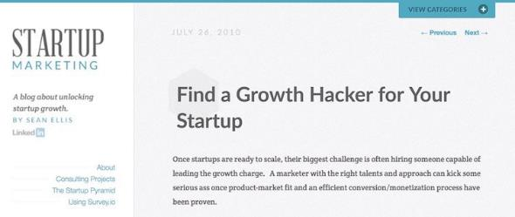
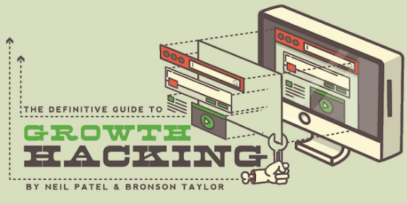
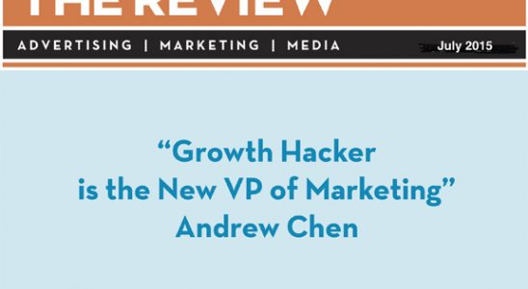
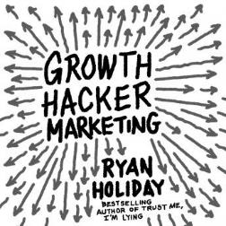
Growth Hacking Story

Slide 3
Growth Hacker Definition
«A person whose true north is growth. Everything they do is scrutinized by its potential impact on scalable growth»
Sean Ellis

Slide 4
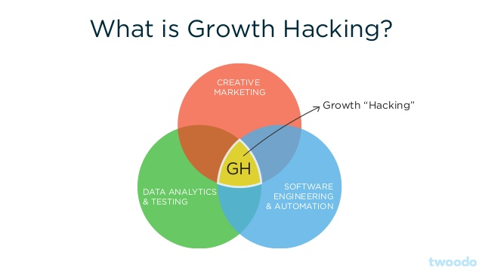
What is growth hacking?
Growth hacking is a process of rapid experimentation across marketing funnel, product development, sales segments, and other areas of the business to identify the most efficient ways to grow a business. A growth hacking team is made up of marketers, developers, engineers and product managers that specifically focus on building and engaging the user base of a business

Slide 5
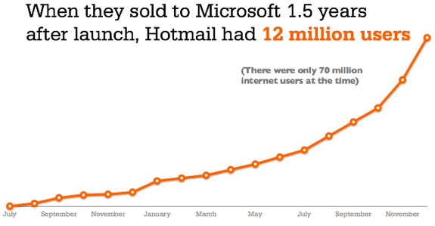
GH Case Study: Hotmail
Launched with an initial investment of $300k in 1996 was sold to Microsoft in 1997 for $400M

Slide 6
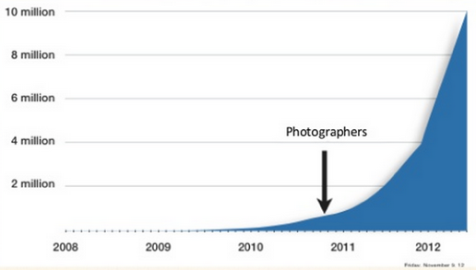
GH Case Study: AirBnB
The «growth hack» of AirBnB was the use of professional photos of apartments, it caused an exponential growth.
The integration with CraigList helped as well.

Slide 7
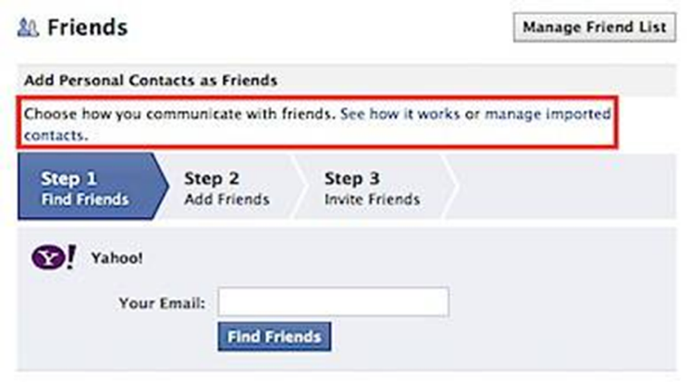
GH Case Study: Facebook
Facebook was among the first services proposing a referral during registration.
This was its best «hack».

Slide 8
GH Case Study: Linkedin
Linkedin hack was the ability in indexing people profiles on Google, so that each time a name and surname is searched, the person Linkedin is listed first.

Slide 9
Growth Hacking is data driven
It’s important to root a project growth on real metrics and not opinions or vanity, from the very first start.

Slide 10
Growth Hacker skills
Curiosity
Multidisciplinary competences
Attention to numbers
Dev skills
Statistical analysis
Creativity

Slide 11
Growth Hacker’s paradise
That very moment you achieve it, it means the project is working fine

Slide 12
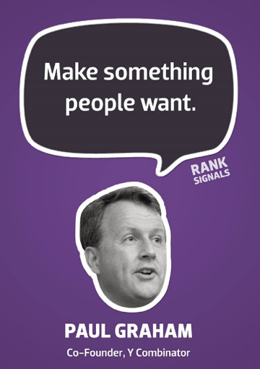
Growth Hacker’s goal
It’s crucial to solve a real customer problem

Slide 13
A Product/Market fit metric
If at least 40% of your customer would feel deeply dissatisfied from your product disappearing from the market, it means you reached a good P/M fit

Slide 14
Thank you

