Slide 1
Competitor Analysis
Version 1.0

Slide 2
What is positioning?
Positioning refers to the place that a brand occupies in the mind of the customer and how it is distinguished from products from competitors.

Slide 3
Example of good positioning
- Feb 2014 : Acquired by FB for 19 Billion USD
- Jan 2017 : 1.2 billion monthly active users

Slide 4
Example of bad positioning
Telegram is better than Whatsapp but nobody knows!

Slide 5
Why?

Slide 6
Market Analysis and Competition
«It’s better to be first in the customer minds than in the market» , Al Ries

Slide 7
Category law
«if you can’t be the first one in a category, create a new category where you can be first»

Slide 8
Positioning
It’s the way a product, service or brand takes its place in the mind of a lead customer.
The mind is always more powerful than the market.

Slide 9
Positioning
For each category each user remembers 2 or 3 brands maximum.

Slide 10
Positioning
Think about:
Sweet cola-based drinks

Slide 11
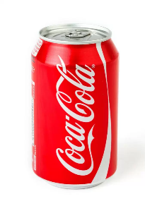
Positioning
Coca Cola

Slide 12
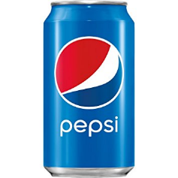
Positioning
PEPSI

Slide 13
Positioning
Think about:
Energy drinks

Slide 14
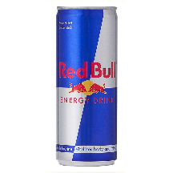
Positioning
Think about:
Energy drinks

Slide 15
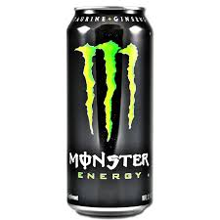
Positioning
Think about:
Energy drinks

Slide 16
Positioning
Think about:
Energy drinks

Slide 17
Market Analysis and Competition
How to approach a need: create a product for an existing market instead of searching a market for your product

Slide 18
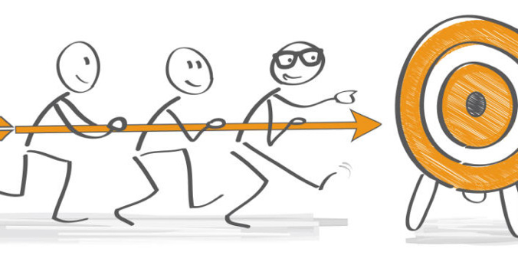
Competitor analysis
Identify potential competitors
Learn from competitors
Replicate best practices
Define your competitive advantage

Slide 19
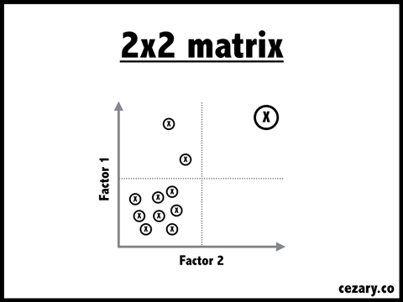
Competitor analysis
Identity the axis, that are the crucial factors in the baseline sector
Position yourself on top right of the matrix to define your competitive advantage

Slide 20
Competitor analysis example
A competitor analisys in the car sector shows an opportunity for affordable family cars.

Slide 21
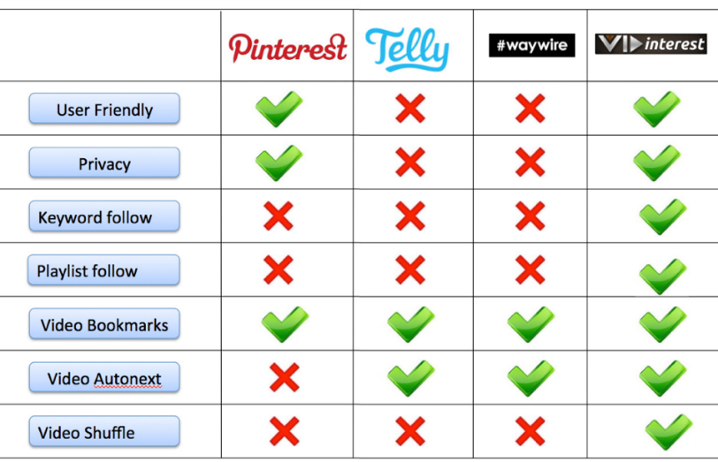
Competitor analysis
Identify the main features of the baseline sector
Compare your features with the same features of your competitors (competitive advantage)

Slide 22
Thank you

